Slide 1


COMPARATIVE STUDY AND MARKETING STRATEGY

Slide 2
1. INTRODUCTION
2. ABOUT
3. USER INTERFACE
4. COMPETITORS
5. SURVEY
6. COMPARATIVE ANALYSIS
7. SWOT ANALYSIS
8. CONCLUSION
9. REFERENCES
CONTENTS

Slide 3
* Comparative analysis of Flipkart with
Amazon, Myntra, Ajio, Meesho.
* Comparing based on their Product range,
Price range , Exclusive collections ,
Multiple payment methods , Offers ,
User interface, Customer services.
INTRODUCTION

Slide 4
ABOUT
FOUNDED | OCTOBER , 2007
FOUNDERS | SACHIN BANSAL & BINNY BENSAL
HEADQUARTERS | BANGLORE , INDIA
EMPLYOYEES | Approximately 42,000 (2024)
INDUSTRY | E - COMMERCE
MARKET SHARE | 34.5 %
OWNER | WALMART Inc. (76.28)
COMPETITORS | AMAZON, MYNTRA, MEESHO, AJIO

Slide 5
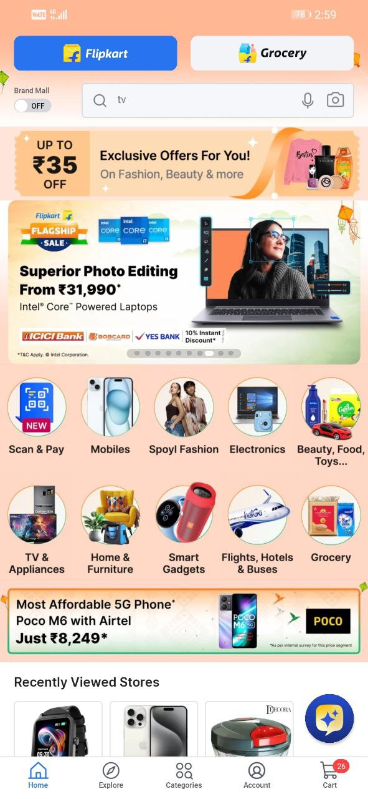
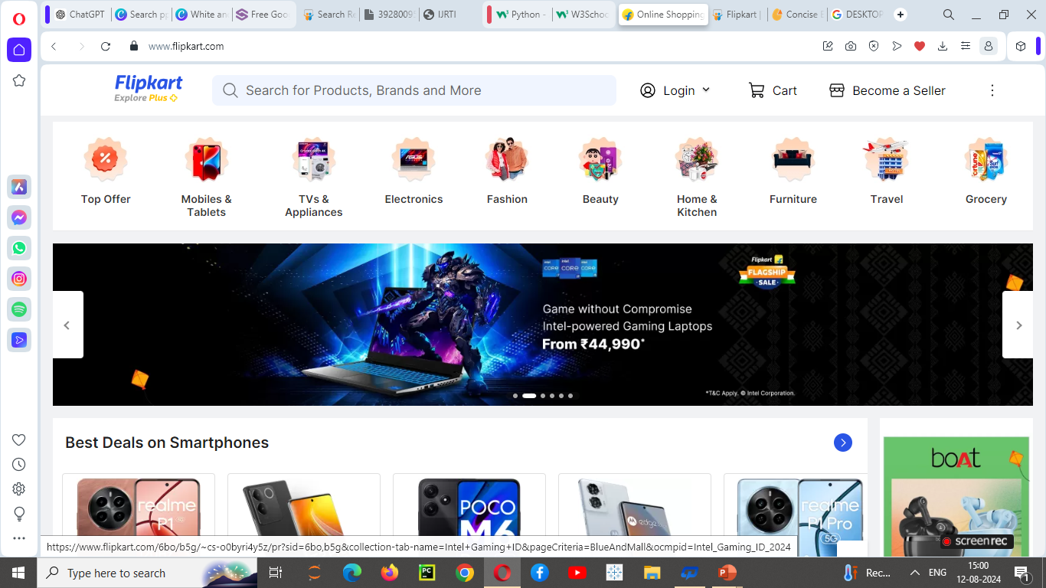
USER INTERFACE

Slide 6




COMPETITORS

Slide 7
https://forms.app/form/66b705546669c6dee8e72b9c/result/statistics
7
SURVEY
To better understand our customer’s needs and preferences ,we conducted a survey.
Survey was designed to gather insights into various aspects of our products and services.
The survey featured twenty questions covering product features ,service quality and overall experience.
The feedback was collected from diverse group of customers who regularly use our products.

Slide 8
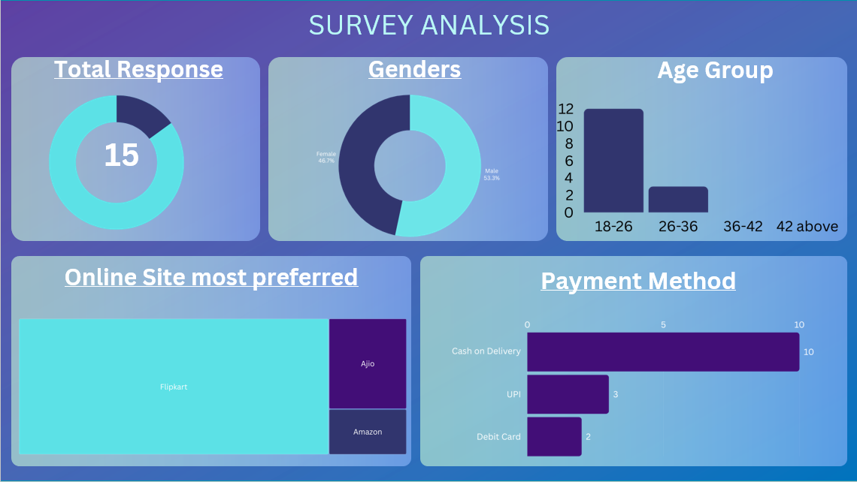
q 8

Slide 9
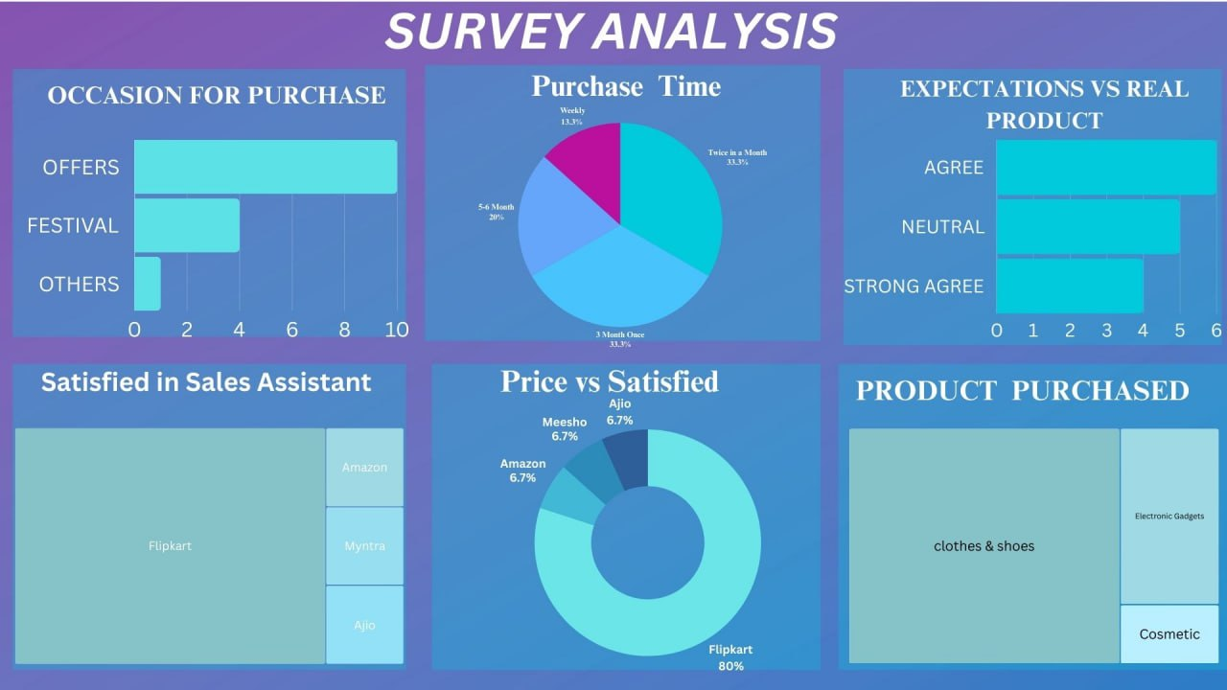
9

Slide 10
COMPARATIVE ANALYSIS

Slide 11
COMPANY OVERVIEW
CATEGORY | FLIPKART | AMAZON | MEESHO | MYNTRA | AJIO
Founded year | 2007 | 1994 | 2015 | 2007 | 2016
Headquarters location | Bengaluru, India | Seattle ,USA | Bengaluru, India | Bengaluru, India | Mumbai, India
CEO/Key executives | Kalyan Krishnamurthy | Andy Jassy | Vidit Aatrey | Nandita Sinha | Isha Ambani

Slide 12
FINANCIAL PERFORMANCE
CATEGORY | FLIPKART | AMAZON | MEESHO | MYNTRA | AJIO
Annual Revenue | $25 billion USD (2024) | $7 billion USD (2024) | $2 billion USD (2024) | $1.2 billion USD (2024) | $1.5 billion USD (2024)
Market Share | 30 -35% | 30 -35% | 5 -10% | 10 -15% | 2 -5%

Slide 13
PRODUCT AND SERVICE OFFERING
CATEGORY | FLIPKART | AMAZON | MEESHO | MYNTRA | AJIO
Product Categories | Electronics, Fashion, Home & Furniture, Books, Groceries, Toys & Baby products, Health & personal care, Sports & Fitness | Electronics, Fashion, Home appliances, Furniture, Books, Groceries, Toys & Games, health & personal care, Automotive | Fashion , Jewelry, Home & Kitchen, Toys & Baby products, Beauty & personal care | Fashion , Jewelry, Home & Lifestyle, Beauty & personal care, Sports & Fitness | Fashion, Footwear, Accessories, Home & Lifestyle, Beauty
Key Features | Big Billion Days, Wide product selection, Flipkart Plus, Customer Support , Cash on Delivery, Personalized recommendations, Product reviews and ratings | Prime Membership, Alexa, Advanced Technology, Fast delivery options, Customer service, Global Marketplace, Extensive product range | Social commerce focus, Affordable fashion, No order minimum quantity, Free returns, Seller support, Wide range of categories, Cash on delivery | Fashion and Lifestyle, Personalized recommendations, Myntra insider program, Wide brand range, Seasonal sales, Virtual try - on | Trendy fashion, Exclusive brands, Seasonal sales and discounts, Curated collections, User friendly interface, Flexible return policy

Slide 14
USER EXPERIENCE AND INTERFACE
CATEGORY | FLIPKART | AMAZON | MEESHO | MYNTRA | AJIO
Homepage Layout | Top navigation bar, Search bar, Main banner, Personalized recommendations, Deals and offers https://www.flipkart.com/ | Top navigation bar, Search bar, Banners and Ads, Personalized recommendations, Quick Links https://www.amazon.in | Top navigation bar, Search bar, Featured collections , Social sharing, Promotions https://www.meesho.com/ | Top navigation bar, Search bar, Main banner, Personalized recommendations, Featured brands https://www.myntra.com/ | Top navigation bar, Search bar, Main banner, Curated collections, Offers & discounts https://www.ajio.com/
Navigation | Category menus, Side filters, Search suggestions | Category dropdowns, Mega menus, Filters & sorting | Simplified categories, Quick access, Mobile-centric | Mega menus, Filters & sorting, Virtual Try-on | Category dropdowns ,filters , Search functionality

Slide 15
MARKETING AND SALES STRATEGIES
CATEGORY | FLIPKART | AMAZON | MEESHO | MYNTRA | AJIO
Marketing channels | TV , Digital Ads, Social media, Email marketing, Content marketing | Social media , Search Ads, Digital advertising, Email marketing, Affiliate marketing | Social media, Influencer Collaborations, Referral programs | Social media , Digital advertising, Email marketing, Content marketing | Social media , Digital advertising, Influencer marketing, Email campaigns
Promotions | Big billion days, Flash sales & discounts, Festive & seasonal sales, Buy one get one offers | Discounts & offers, Prime day & festive sales, Flash sales | Discounts & offers, Flash sales, Cashbacks | End of Season sale, Loyalty rewards, Seasonal discounts | Exclusive Discounts, Seasonal sales, Flash sales

Slide 16
TECHNOLOGICAL CAPABILITIES
CATEGORY | FLIPKART | AMAZON | MEESHO | MYNTRA | AJIO
Innovations | AI, Personalized Offers | AI, Machine Learning | Social commerce Tools | Fashion Focused Algorithms | Trendy Product recommendations

Slide 17
SWOT ANALYSIS
STRENGTHS Strong brand value Wide range of products and categories User-friendly interface Good customer support Innovative Technology | WEAKNESSES High competition. Profitability issues Brand perception and trust issues Dependency on discounts and promotions Customer service challenges
OPPORTUNITIES Growing E- Commerce market Rural market expansion Diversification Partnerships and Acquisition | THREATS Fluctuating economy , Unfavorable market conditions and government policies From competitors like Amazon, Myntra, Meesho , Ajio Cybersecurity risks

Slide 18
CONCLUSION
Our comparative analysis of Flipkart with Myntra, Amazon, Meesho, and Ajio highlights the unique strengths and weaknesses of each platform.
Flipkart's aggressive promotional strategies, extensive product range, and strong customer loyalty programs position it as a leader in India's e-commerce market.
However, Amazon's global expertise, Myntra's fashion focus, Meesho's social commerce approach, and Ajio's modern aesthetic offer distinct advantages.
As the Indian e-commerce landscape continues to evolve, each platform must adapt to changing consumer preferences and technological advancements to remain competitive.

Slide 19
* https://www.wikipedia.org/
* file:///C:/Users/user/Downloads/39280095%20THAANESHWAR.pdf
* https://www.amazon.in
* https://www.meesho.com/
* https://www.ajio.com/
* https://www.myntra.com/
* https://www.flipkart.com/
REFERENCES

Slide 20
THANK YOU

